Slide 1
Sampler Coupling Report
data for freq sampler scaling. correct bias list

Slide 2
Test Configuration
Frequencies: (GHz)
12, 11.9, 11.8, 11.7, 11.6, 11.5, 11.4, 11.3, 11.2, 11.1, 11, 10.9, 10.8, 10.7, 10.6, 10.5, 10.4, 10.3, 10.2, 10.1, 10, 9.9, 9.8, 9.7, 9.6, 9.5, 9.4, 9.3, 9.2, 9.1, 9, 8.9, 8.8, 8.7, 8.6, 8.5, 8.4, 8.3, 8.2, 8.1, 8
Input Powers: (dBm)
10, 12, 14, 16, 18, 20, 22, 24, 26
Sampler DC Bias
1.25
Load Impedances:
Gamma Magnitude:
0
Gamma Phase
0

Slide 3
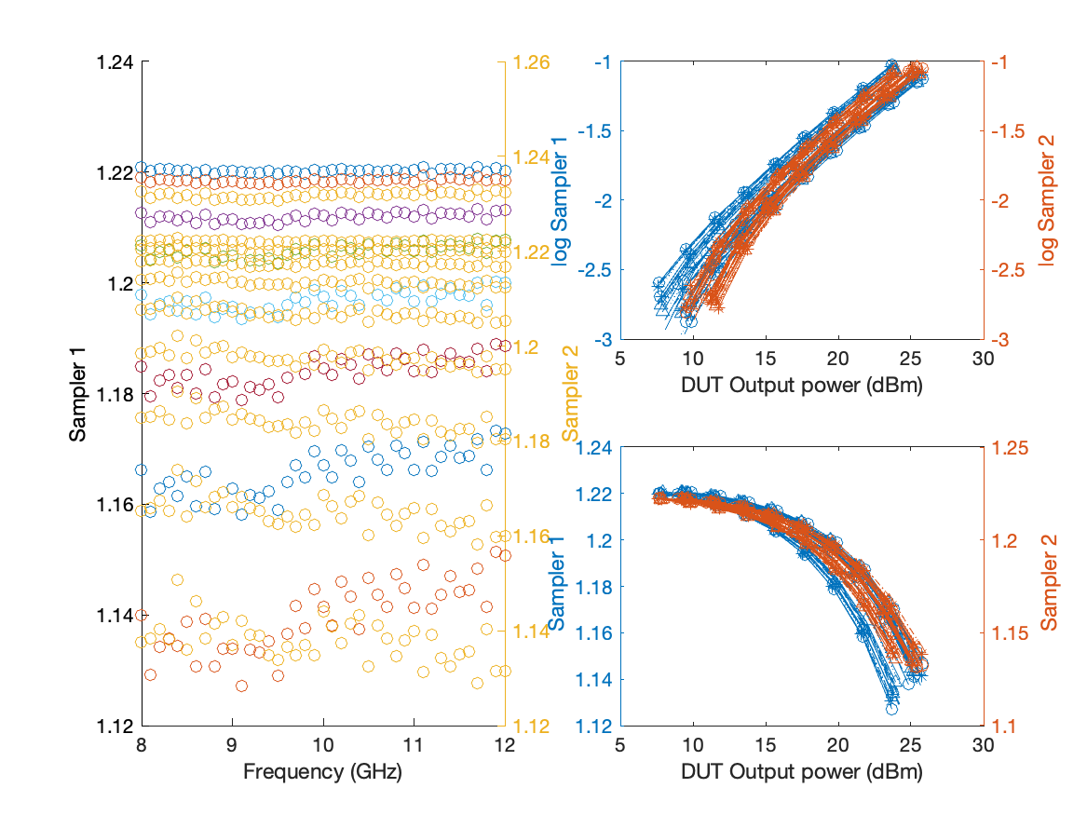
Large Signal Performance

